Slide 1


Finding optimal bar locations near Groningen city center
Jamo Momand
December 31st 2020
IBM Applied Data Science Capstone

Slide 2
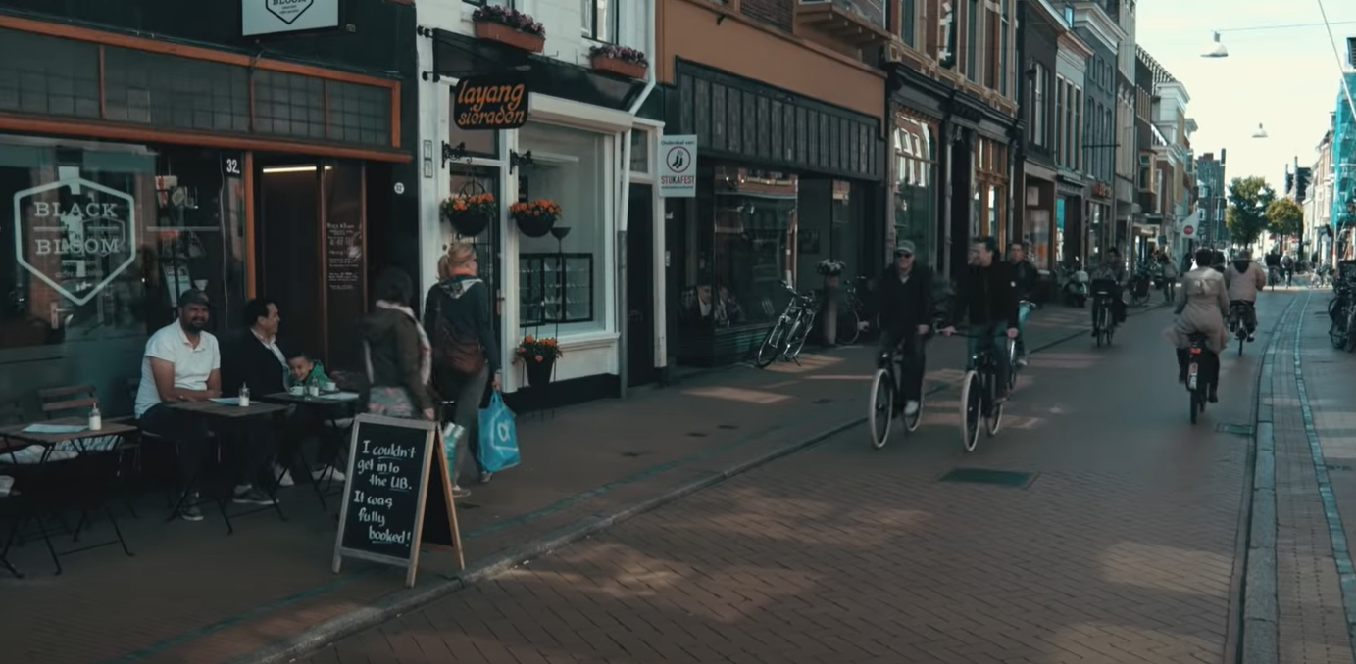
Introduction: Business Problem
Groningen, the Netherlands
Optimal new bar/restaurant locations
Target audience: prospective bar/restaurant owners

Slide 3
Data
Neighborhood data: municipality website
Coordinate data: Nominatim from Geopy
Venue data: Foursquare

Slide 4
Methodology
KMeans clustering
Elbow method: Yellowbrick
Inner and outer city center will be excluded after analysis

Slide 5
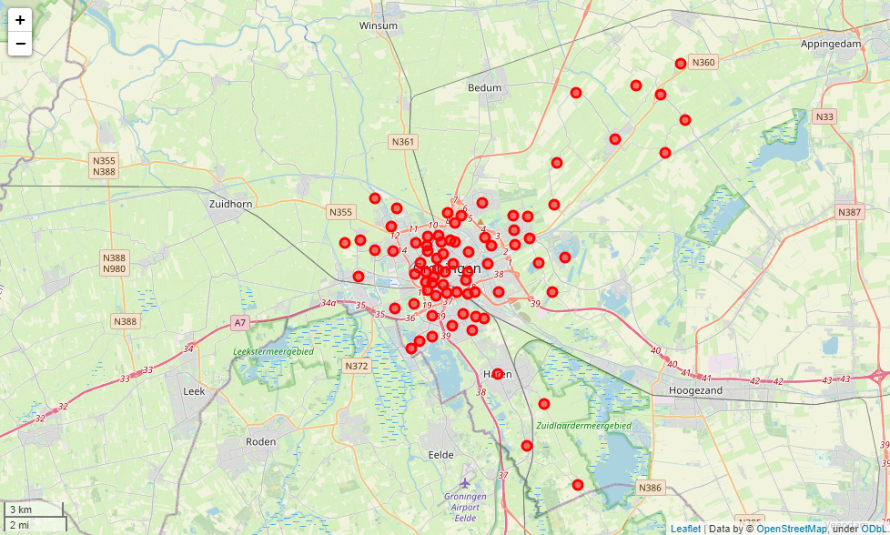
Results and Discussion
Data collection
Data understanding
Data cleaning
Good agreement

Slide 6
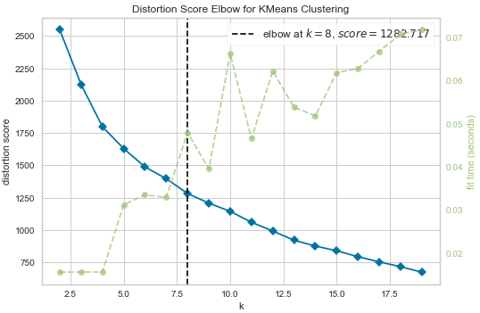
Results and Discussion
KMeans clustering
Elbow method with Yellowbrick
Optimal #cluster set to 8

Slide 7
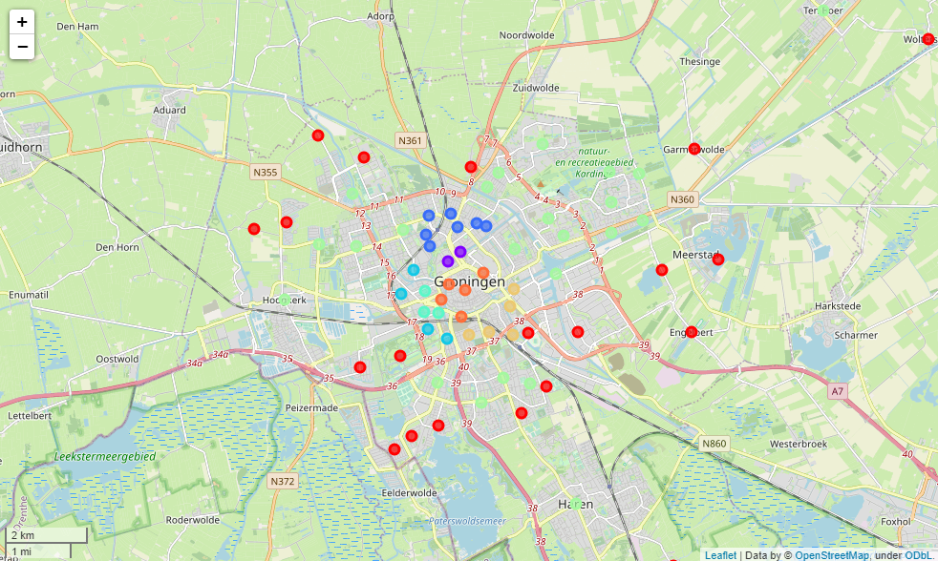
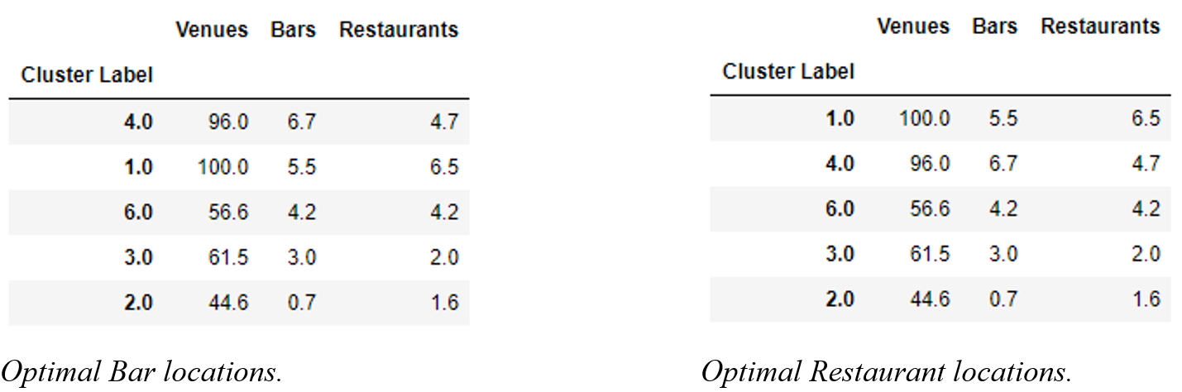
Results and Discussion
Purple – 0, Red – 1
Dark Blue – 2, Blue – 3
Light Blue – 4, Green – 5
Beige – 6, Orange – 7

Slide 8
Conclusion
Optimal neighborhoods for bars and restaurants found
Data and analysis optimization discussed
Advice depends on stakeholder (livelihood vs. niche)

